Slide 1

Internship Experience
Mingjun Ying
MediaTek USA Inc. (New Jersey)
30 Independence Blvd., Suite 510
Warren, NJ 07059

Slide 2

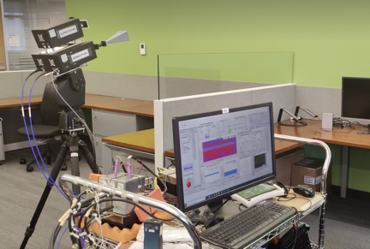
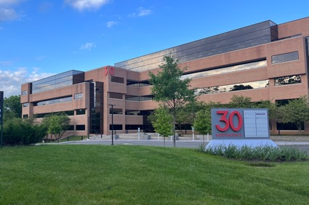
About Me
Education:
New York University
Ph.D. in Electrical Engineering
green communication, channel propagation measurements and modeling, ray-tracing, resource allocation and backscatter communication, etc.
Experience:
6G Wireless and Machine Learning Intern
MediaTek, New Jersey

Slide 3
Why MediaTek
Opportunities at MediaTek:
MediaTek has provided me with an opportunity to do innovative projects that extend beyond my PhD research.
This allows me to explore new areas and acquire valuable skills, contributing to both my professional growth and the success of MediaTek's initiatives.
Supportive and Passionate Work Environment:
MediaTek at New Jersey has a small but highly collaborative team.
Every team member is passionate about their work.
Future Collaboration:
The opportunity to work alongside talented professionals at MediaTek has enriched my understanding of industry work style.
MediaTek has joined the Industrial Affiliates Program of NYU WIRELESS, and even after the internship, we will continue to collaborate on my PhD project.

Slide 4
What I Have Learned
Industry Work Style:
Gained insight into the fast-paced and results-driven nature of the industry.
Learned to adapt quickly to changing project requirements and priorities.
Problem-Solving Under Time Constraints:
Learned to prioritize tasks, and deliver results within deadlines.
Consider more realistic problems than academia.
Collaboration and Teamwork:
Learned to communicate effectively with colleagues, share ideas.

Slide 5
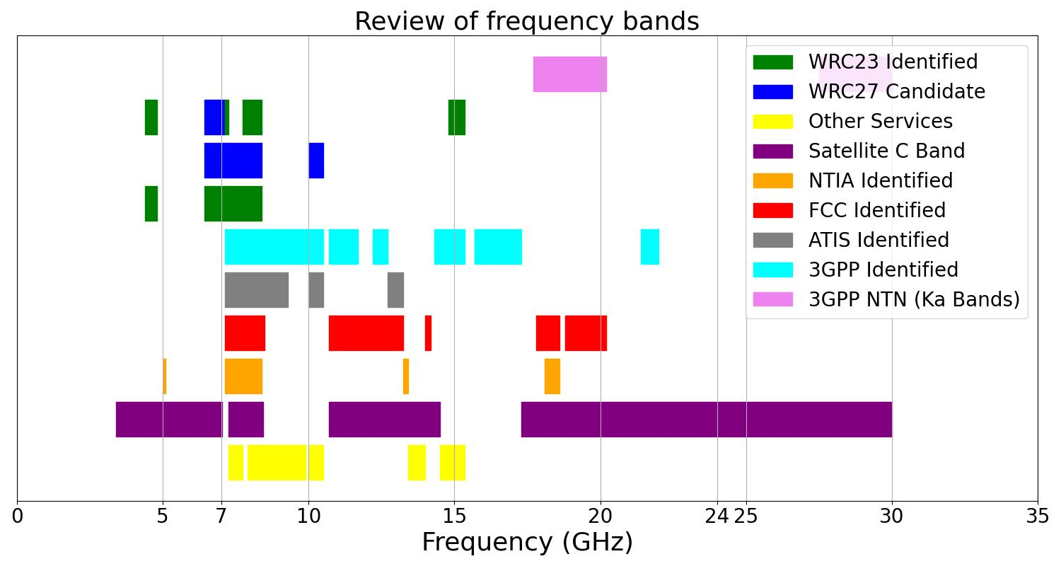
What is my project
Co-Existence between Non-Terrestrial Network (NTN) and Terrestrial Network (TN)—Spectrum Sharing and Interference Management
S-band
Ku-band
Ka-band

Slide 6
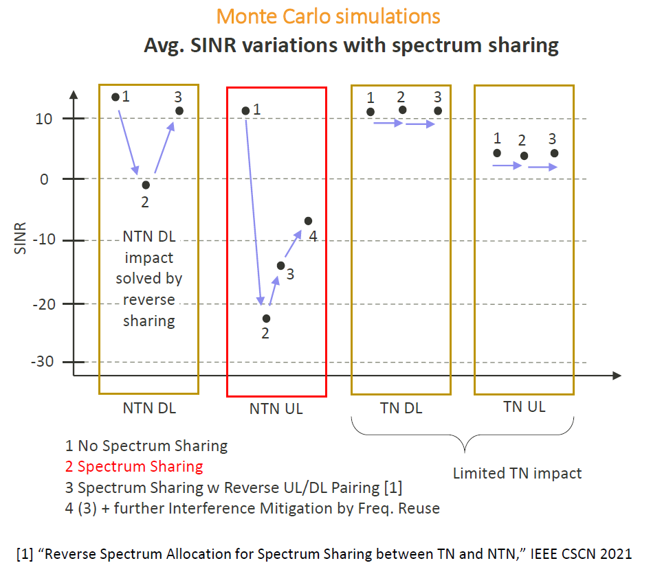
MediaTek Previous Interference Management
SINR
Gap
NTN uplink (UL) performance is bad, and interference management still needs improvement.

Slide 7
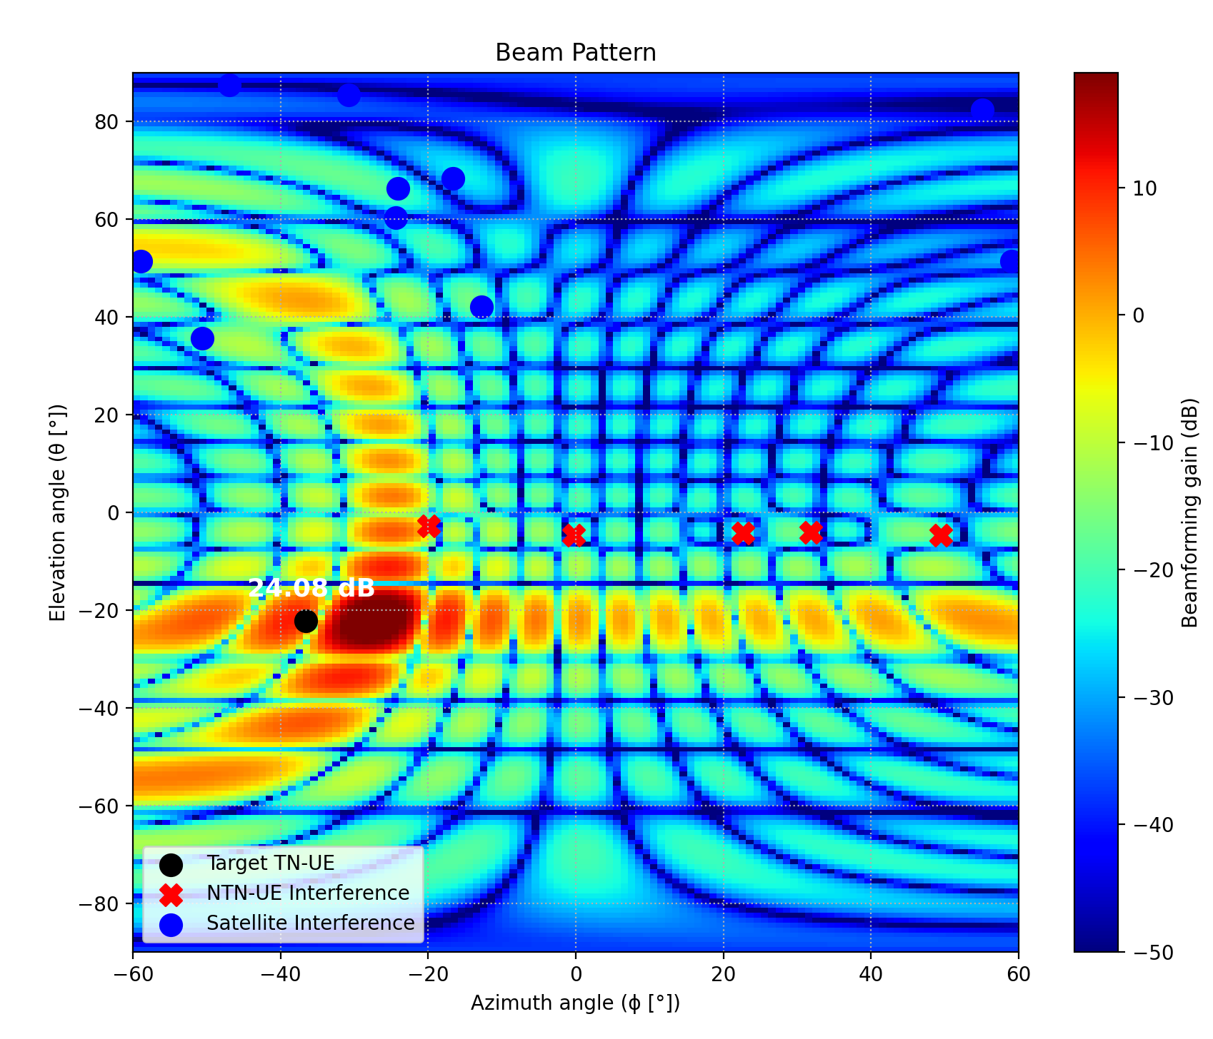
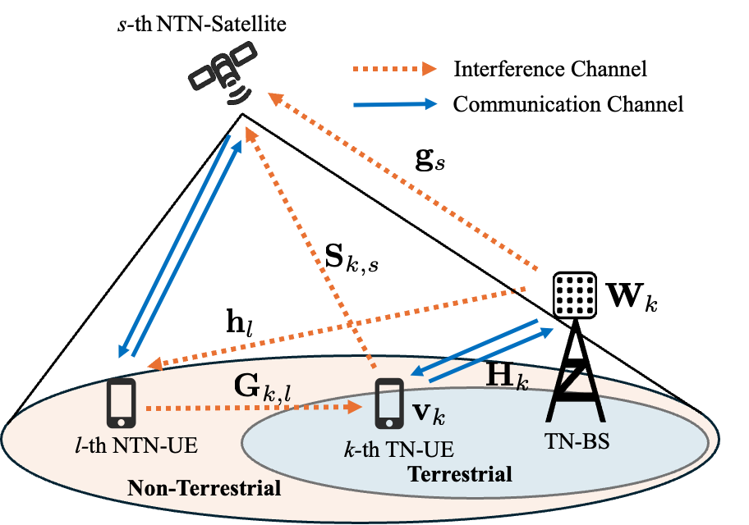
My Interference Management Approach
System model
BF gain pattern of TN-BS

Slide 8
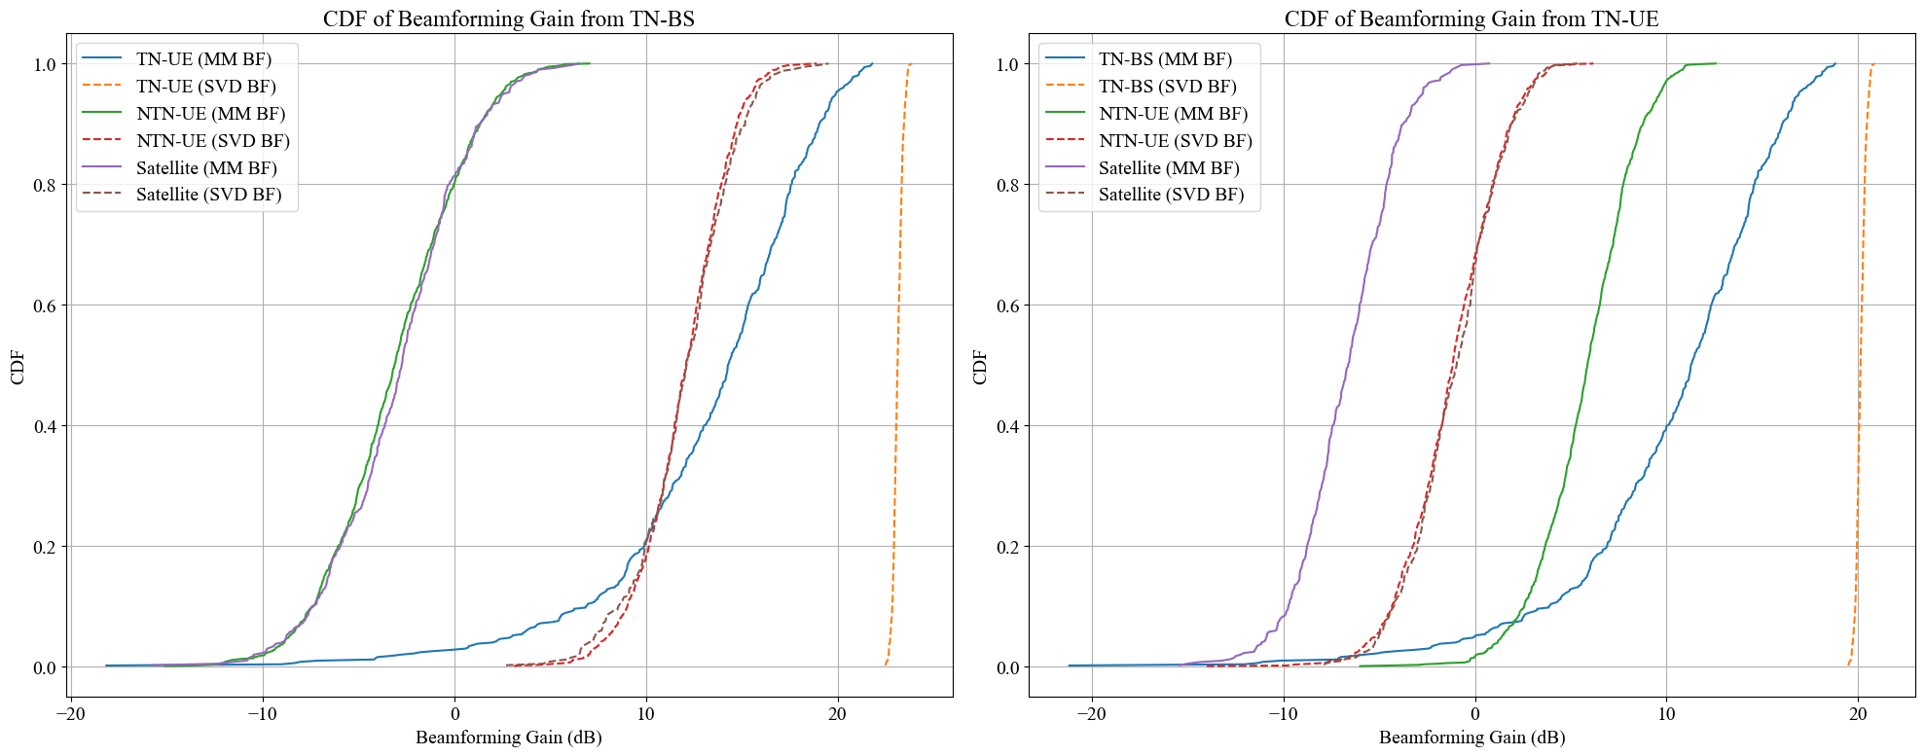
Efficient Joint Beamforming Optimization
URA BS: 8 X 8 ; UE: 4 X 4

Slide 9
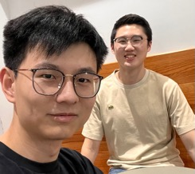

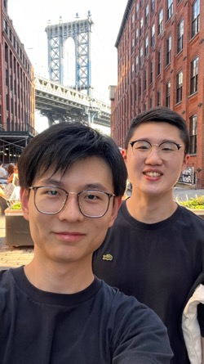
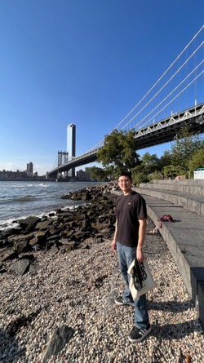
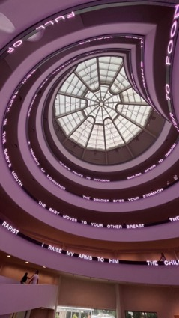
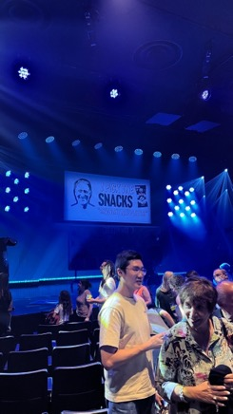
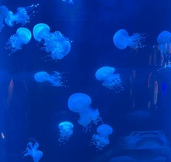


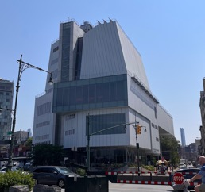
Fun time with colleagues

